Slide 1
Stock price Prediction and visualization: a study case for us and uk markets
Team 5
Ioana-Cristina Mihai
Mihnea Prodea
Vlad Simion

Slide 2
CONTENTS
Introduction
Objectives
Project Build-Up
Data Collection & Results
Summary

Slide 3



MEET OUR TEAM
Ioana-Cristina Mihai
Mihnea Prodea
Vlad Simion​

Slide 4
INTRODUCTION
The ability to foresee market movements is more crucial than ever in such a dynamic landscape.
For inverstors to properly manage their portfolios, they need to visualize datasets, find useful patterns and gain valuable insights such as a stock daily returns and risks.
We are to present in the following slides how Python can help perform stock data visualization and comparison.

Slide 5
Disclaimer: This project is not to be used as investing advice as it is only a model using an occurring neural network using the last “N” DAYS TO PREDICT ONE DAY INTO THE FUTURE

Slide 6
Objectives
Provide a comprehensive analysis of the two major indices – considered crucial benchmarks – in UK and US markets;
Understand the current state of these market stocks;
Identify trends and patterns;
Compare the proposed model to the real one;
Compare the two indices;
Analyze the role of key sectors in shaping these trends

Slide 7
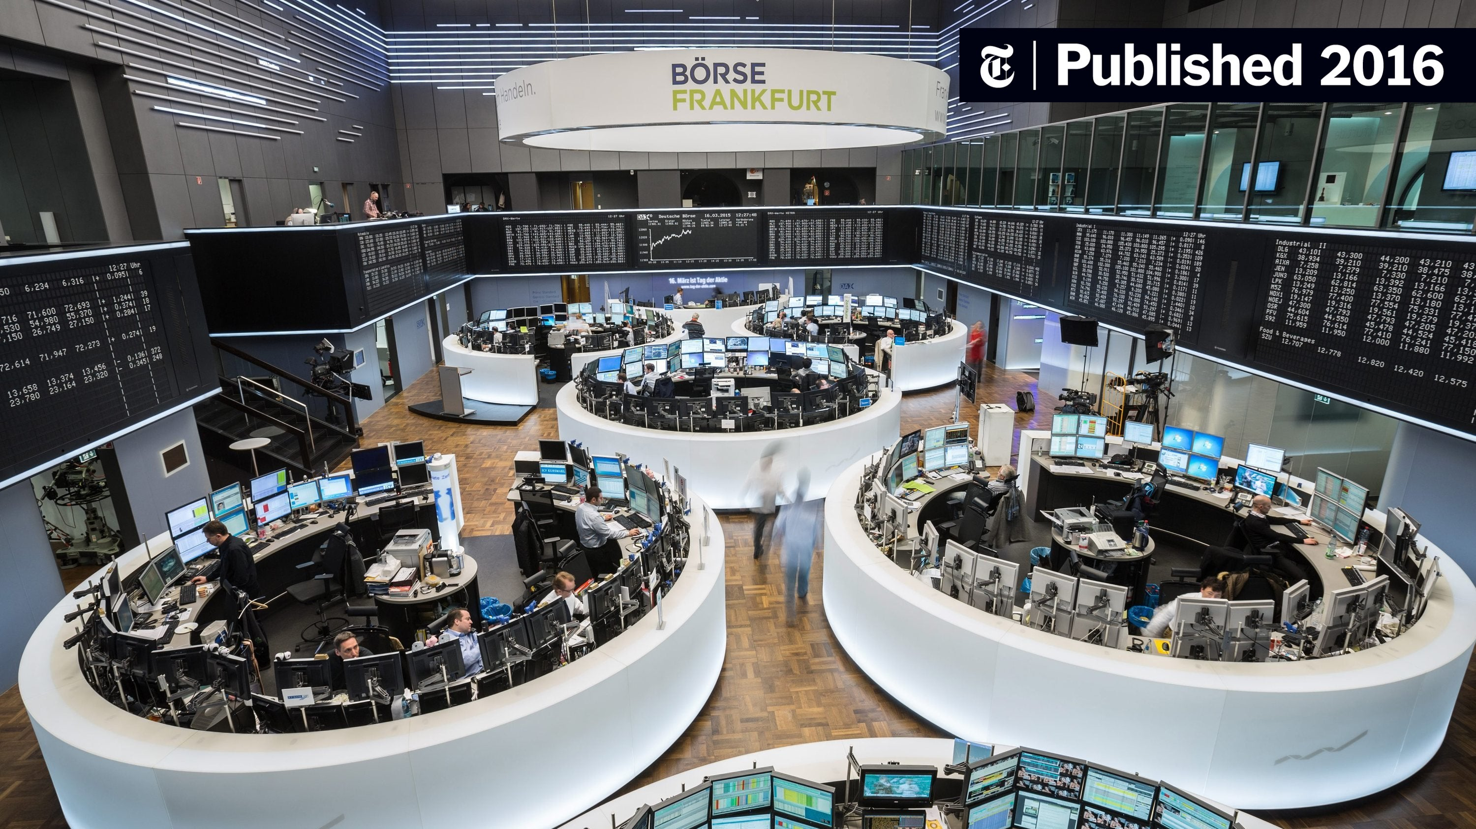
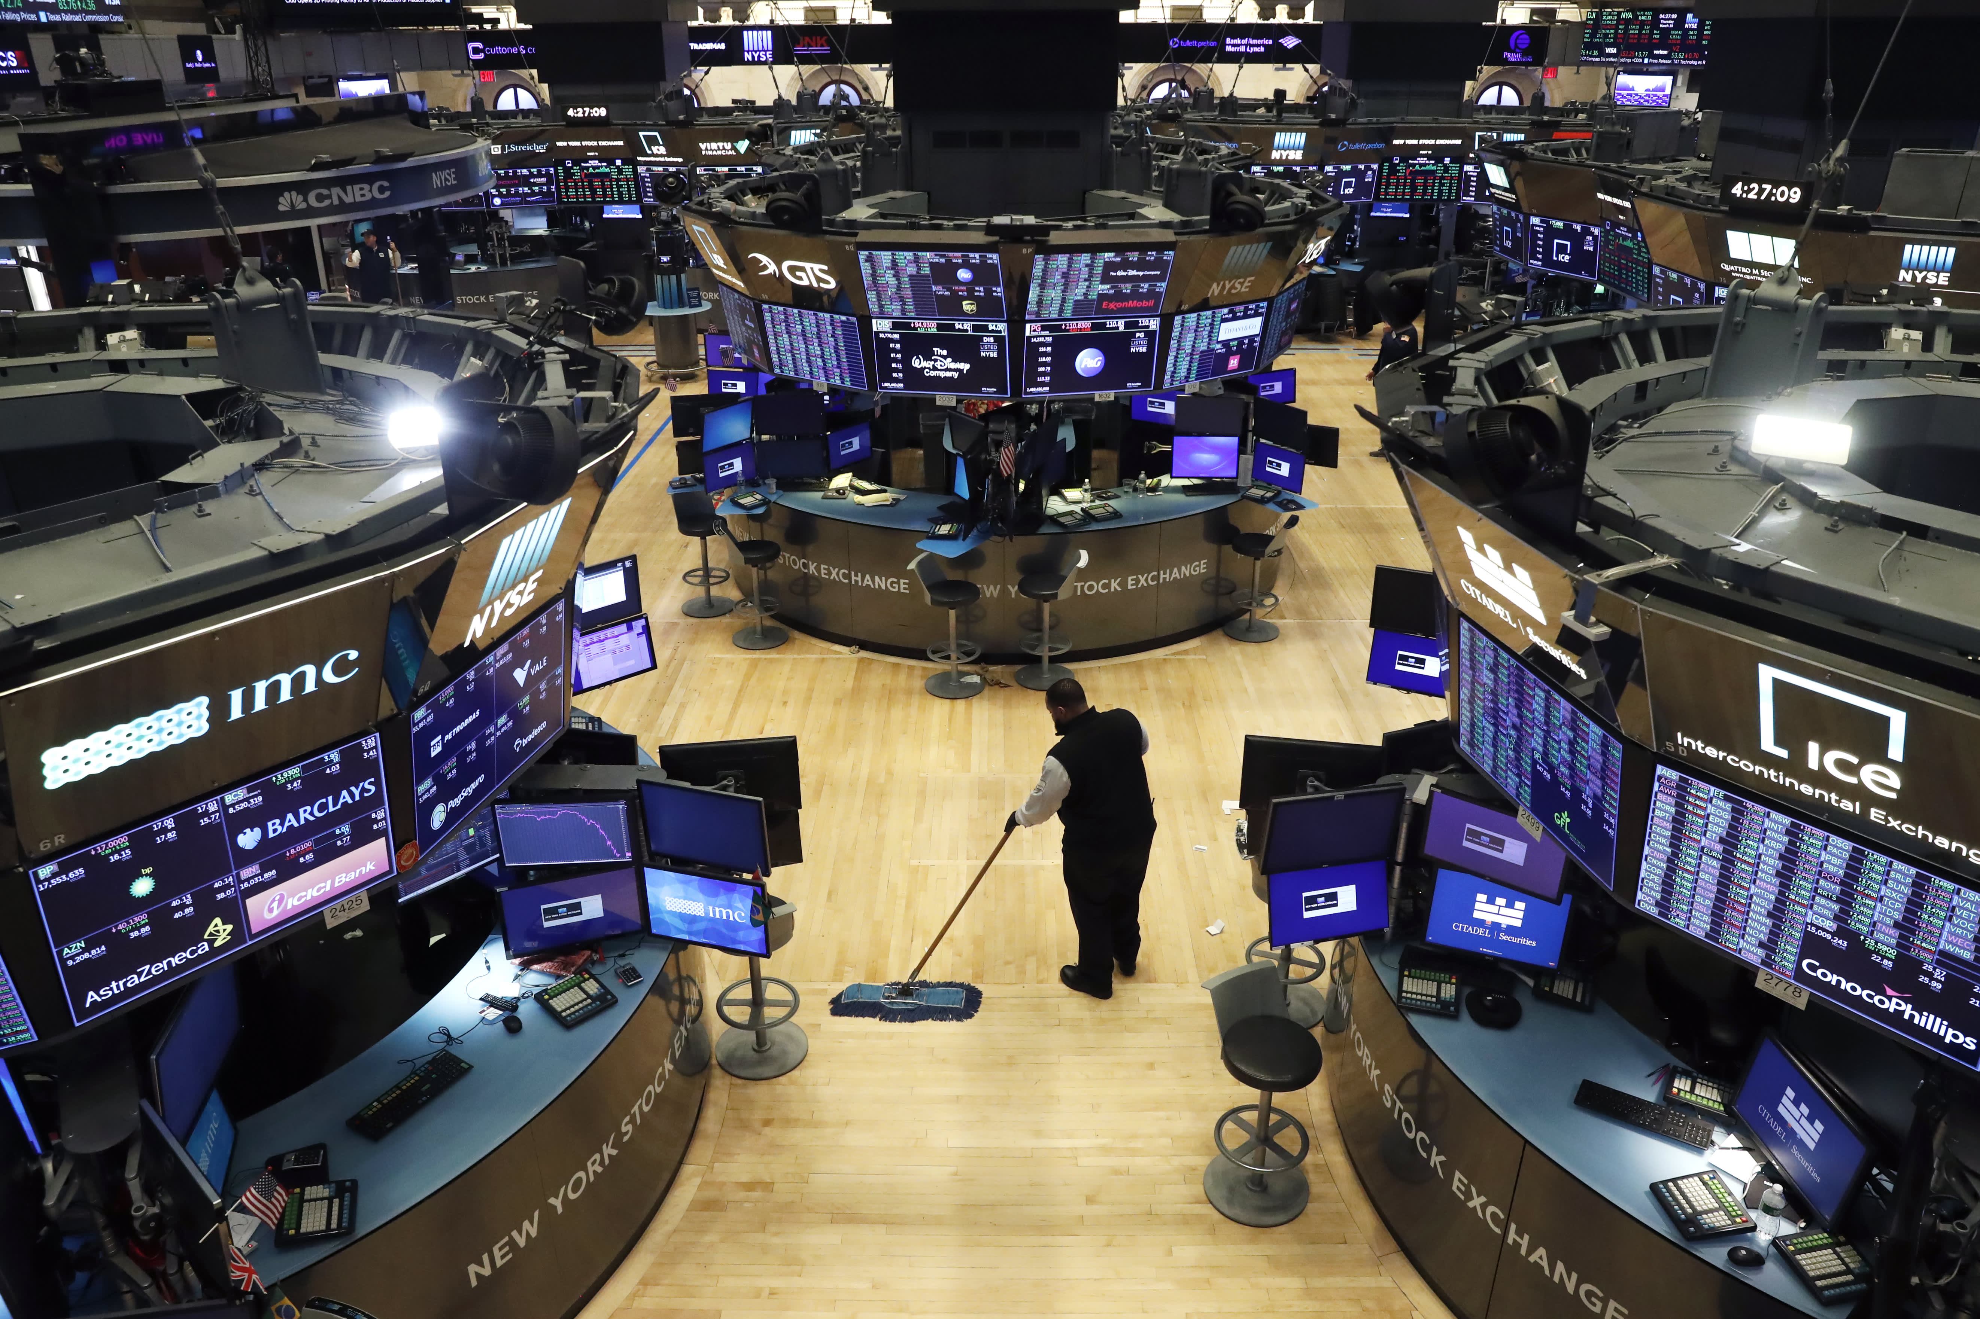
UK VS US- overview
Stock Market Analysis:
- the process of evaluating the performance of stocks and other securities in order to make informed investment decisions. It involves analyzing financial statements, economic indicators, and market trends to determine the value of a particular stock or portfolio of stocks.
The UK stock market is dominated by a few key players, including HSBC, Barclays, and Lloyds Banking Group. These companies have a significant impact on investor sentiment and can influence the overall performance of the market.
The US stock market is also dominated by a few key players, including JPMorgan Chase, Bank of America, and Citigroup. These companies have a significant impact on investor sentiment and can influence the overall performance of the market.

Slide 8
FTSE 100 VS S&p 500- overview
Representation: S&P 500 represents a broad cross-section of the U.S. stock market, including some of the largest and most established companies. FTSE 100 represents the London Stock Exchange's top 100 companies by market capitalization.
Investment Performance: Many investment funds, including index funds and exchange-traded funds (ETFs), use these indices as benchmarks. Investors often compare their investment performance to these indices to assess how well their portfolios are doing relative to the overall market. Changes in these two are often considered indicators of the overall health and direction of the economy.
Global Impact: The S&P 500, being one of the most widely followed indices globally, can impact financial markets worldwide. Changes in the index can influence investor sentiment and trading decisions internationally. Institutional investors and portfolio managers use these indices for risk management and asset allocation.

Slide 9




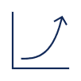
Project BUILDUP
Step 1
Step 2
Step 3
Step 4
Step 5
Define the technologies used
Data collection
Model Architecture
Training and testing
Results and code overview

Slide 10
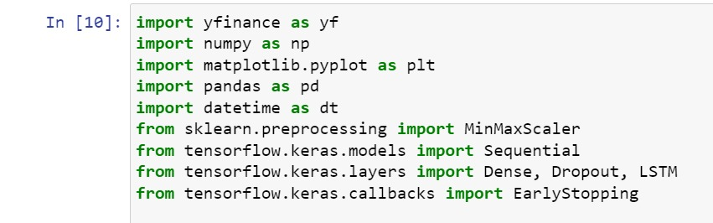
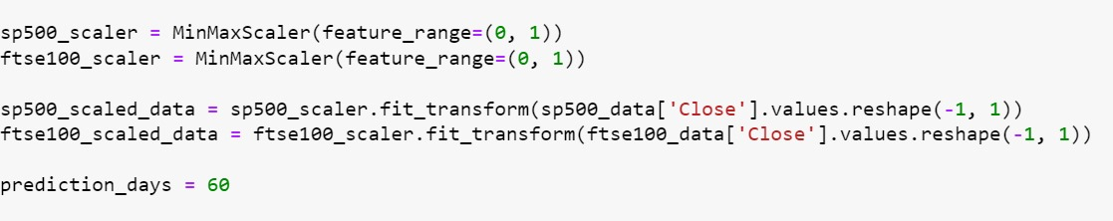
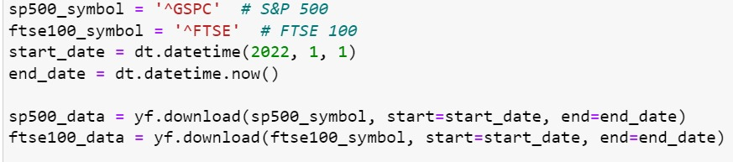
Understanding the code
Importing libraries
Data processing
Define function to plot predictions
Loading data

Slide 11
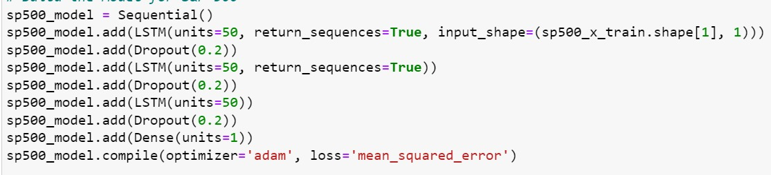
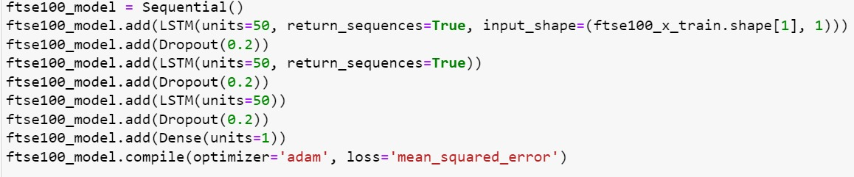
Understanding the code
Build the training model

Slide 12
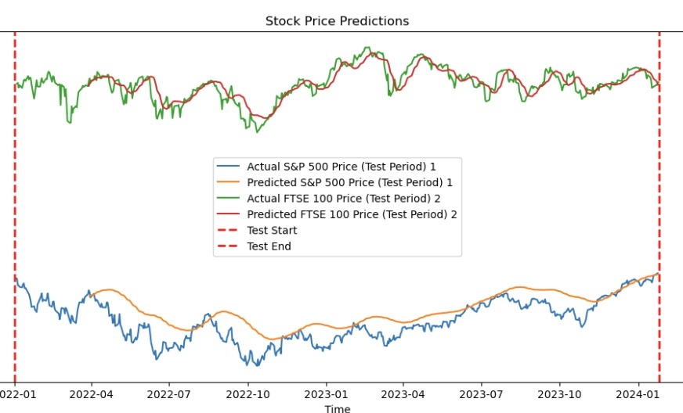
Understanding the code
Plotting predictions

Slide 13
HOW TO GET HERE
Strategize
Utilize resources
Optimize
Do research and gather historical stock data from Yahoo finance;
Python with its versatile libraries
Follow the markets closely​
Be cautious of missing headers or libraries
Start small. Build on something that is working.
We applied ”early stopping” callback
Prototype and test. Repeat

Slide 14
SUMMARY
We used advanced neural network models to try and predict stock prizes for two major indices: S&P 500 in the United States and FTSE 100 in the United Kingdom.
By employing LSTM networks we achieved these predictions and visualized them compared to real statistics to see how efficient the model is. This tool provided us with valuable insights into market trends and served as an educational resource for better understanding the intersection between finance and technology

Slide 15
THANK YOU
Team 5
GitHub
iCloud

